Slide 1



CHM 103: Organic Chemistry I
Presented by:
Assoc Prof Okoli BJ MRSC, MACS
Department of Chemical Science,
Faculty of Science & Technology
Bingham University
The University with the difference
Bingham University

Slide 2
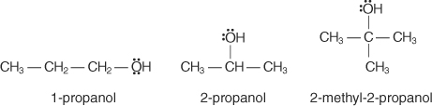
Alcohols
Alcohols are hydroxy‐substituted alkanes, alkenes, or alkynes in which the substitution occurs on a saturated carbon.
The general formula for alcohols is CnH2n+1 OH
E.g.
Nomenclature
In the IUPAC system, use the following series of rules to name alcohols:
1. Pick out the longest continuous chain to which the hydroxyl group is directly attached. The parent name of the alcohol comes from the alkane name for the same chain length. Drop the ‐e ending and add ‐ol.
2. Number the parent chain so that the carbon bearing the hydroxyl group has the lowest possible number. Place the number in front of the parent name.
3. Locate and name substituents other than the hydroxyl group.
The following examples show how you apply these rules:
Bingham University

Slide 3
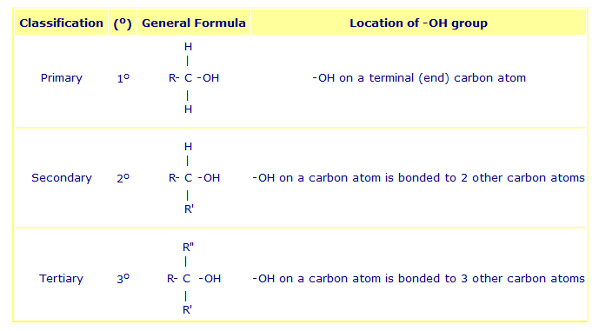
Classification of alcohols
Depending on the location of the OH (hydroxyl or hydroxy) functional group, alkanols can be classified as one of the following:
⚛ primary alcohols (1º)
⚛ secondary alcohols (2º)
⚛ tertiary alcohols (3º)
Bingham University

Slide 4
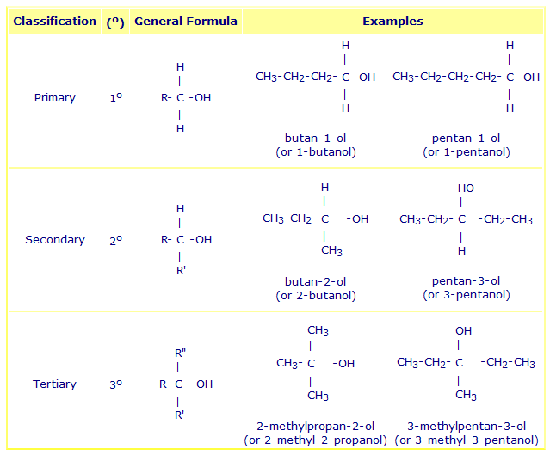
The table below gives examples of primary, secondary and tertiary alkanols:
Bingham University

Slide 5
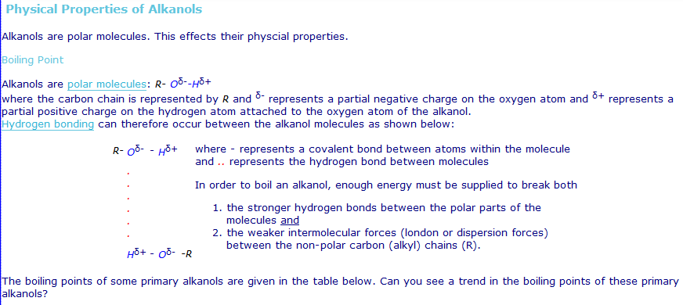
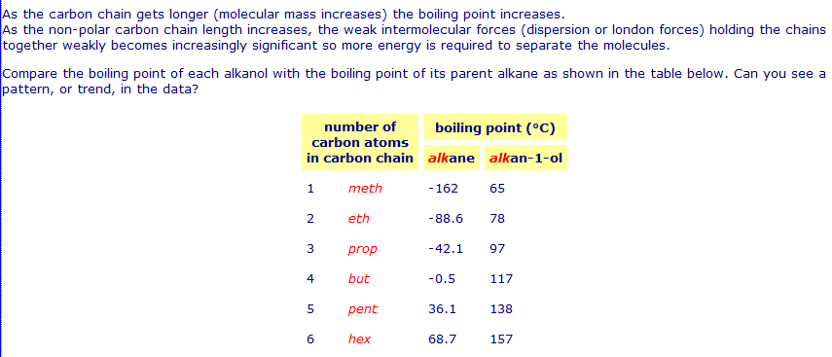
Bingham University

Slide 6
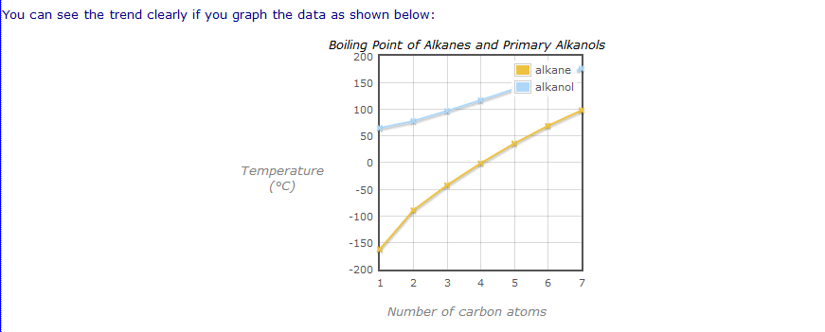
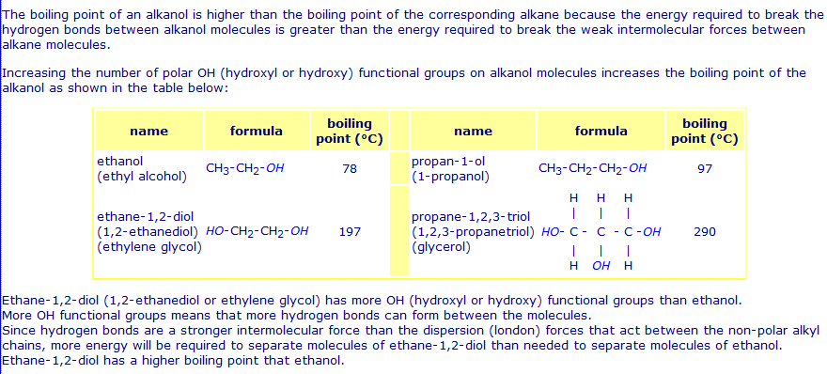
Bingham University

Slide 7
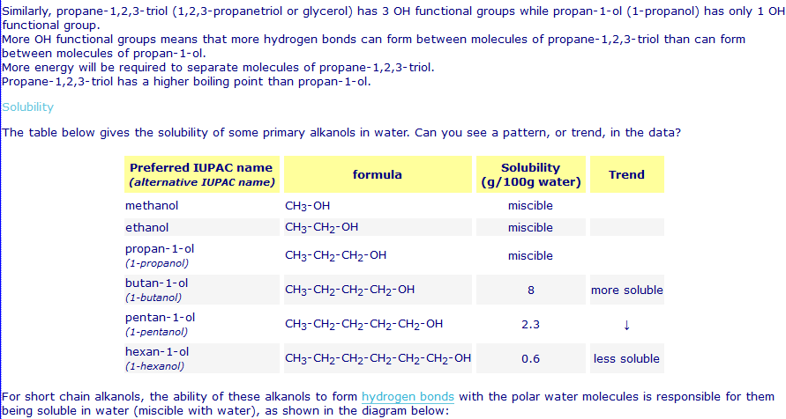
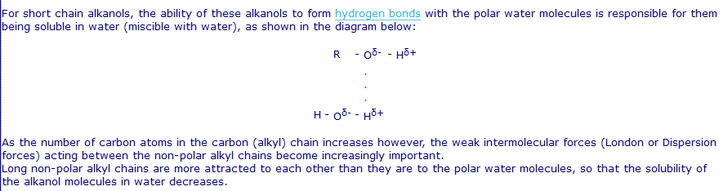
Bingham University

Slide 8
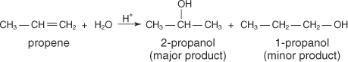
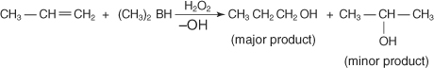
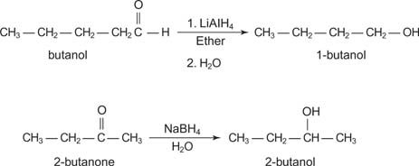
Synthesis of Alcohols
1. Hydration of alkenes
The elements of water can be added to the double‐bonded carbons of an alkene in either a Markovnikov's or an anti‐Markovnikov's manner. As shown below, a hydrogen ion catalyzes the Markovnikov's addition.
The anti‐Markovnikov's addition results from a hydroboration‐oxidation reaction.
2. Reduction of aldehydes and ketones
These types of compounds are best reduced by complex metal hydrides, such as lithium aluminum hydride (LiAlH4) or sodium borohydride (NaBH4).
Following are two examples of complex metal reductions:
Bingham University

Slide 9
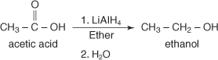
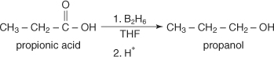
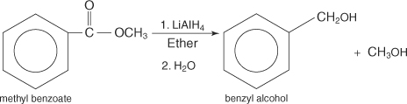
3. Reduction of carboxylic acids
The reduction of a carboxylic acid leads to the formation of a primary alcohol. This reduction requires a very strong reducing agent, and lithium aluminum hydride is the standard choice.
Diborane, B 2H 6, also reduces carboxylic acids to alcohols.
4. Reduction of esters
Esters, like carboxylic acids, are normally reduced with lithium aluminum hydride. In these reactions, two alcohols are formed. An example is the reduction of methyl benzoate to benzyl alcohol and methanol.
5. Grignard reaction with aldehydes and ketones
The Grignard reaction is the only simple method available that is capable of producing primary, secondary, and tertiary alcohols.
Bingham University

Slide 10
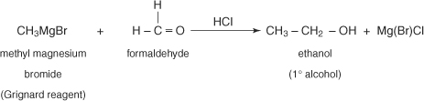
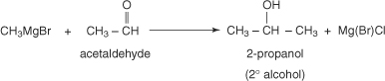
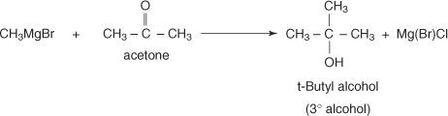
To produce a primary alcohol, the Grignard reagent is reacted with formaldehyde.
Reacting a Grignard reagent with any other aldehyde will lead to a secondary alcohol.
Finally, reacting a Grignard reagent with a ketone will generate a tertiary alcohol.
Bingham University

Slide 11
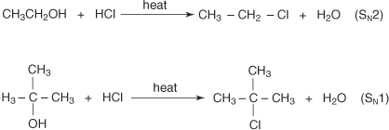
Reactions of Alcohols
1. Metal salt formation
Alcohols are only slightly weaker acids than water, with a K a value of approximately 1 × 10 −16. The reaction of ethanol with sodium metal (a base) produces sodium ethoxide and hydrogen gas.
.
The acidity of alcohols decreases while going from primary to secondary to tertiary. This decrease in acidity is due to two factors:
an increase of electron density on the oxygen atom of the more highly‐substituted alcohol, and
steric hindrance (because of the alkyl groups, which inhibit solvation of the resulting alkoxide ion).
Both of these situations increase the activation energy for proton removal.
2. Alkyl halide formation
Alcohols are converted to alkyl halides by S N1 and S N2 reactions with halogen acids.
Primary alcohols favour S N2 substitutions while S N1 substitutions occur mainly with tertiary alcohols.
Bingham University

Slide 12
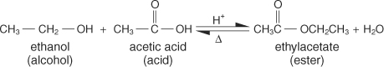
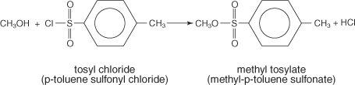
A more efficient method of preparing alkyl halides from alcohols involves reactions with thionyl chloride (SOCl2).
Because thionyl bromide is relatively unstable, alkyl bromides are normally prepared by reacting the alcohol with phosphorous tribromide (PBr 3).
3. Ester formation
Esters are compounds that are commonly formed by the reaction of oxygen‐containing acids with alcohols. Alcohols can be converted to esters by means of the Fischer Esterification Process.
4. Alkyl sulfonate formation. Alcohols may be converted to alkyl sulfonates, which are sulfonic acid esters. These esters are formed by reacting an alcohol with an appropriate sulfonic acid. For example, methyl tosylate, a typical sulfonate, is formed by reacting methyl alcohol with tosyl chloride.
Bingham University

Slide 13
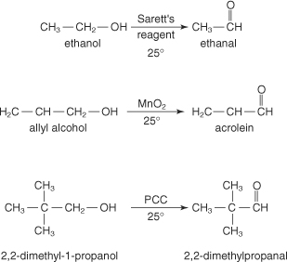
5. Formation of aldehydes and ketones: The oxidation of alcohols can lead to the formation of aldehydes and ketones. Aldehydes are formed from primary alcohols, while ketones are formed from secondary alcohols.
Because you can easily further oxidize aldehydes to carboxylic acids, you can only employ mild oxidizing agents and conditions in the formation of aldehydes.Typical mild oxidizing agents include manganese dioxide (MnO 2), Sarett‐Collins reagent (CrO 3—(C5H5N2), and pyridinium chlorochromate (PCC).
Bingham University

Slide 14
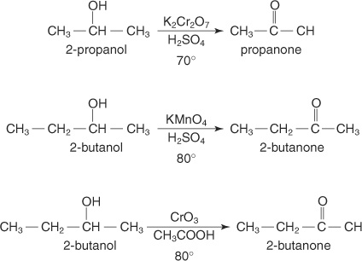
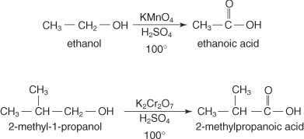
Because ketones are more resistant to further oxidation than aldehydes, we may employ stronger oxidizing agents and higher temperatures. Secondary alcohols are normally converted to ketones by reaction with potassium dichromate (K2Cr2O7), potassium permanganate (KMnO 4), or chromium trioxide in acetic acid (CrO3/CH 3COOH).
6. Carboxylic acid formation: Upon oxidation with strong oxidizing agents and high temperatures, primary alcohols completely oxidize to form carboxylic acids. The common oxidizing agents used for these conversions are concentrated potassium permanganate or concentrated potassium dichromate.
Bingham University

Slide 15

Bingham University

